Slide 1
Data Mining
Course Overview

Slide 2
About the course – Administrivia
Instructor:
  George Kollios, gkollios@cs.bu.edu
    MCS 288, Mon 2:30-4:00PM and Tue 10:25-11:55AM
Home Page:
  http://www.cs.bu.edu/fac/gkollios/dm07
    Check frequently! Syllabus, schedule, assignments, announcements…

Slide 3
Grading
Programming projects (3) 35%
Homework set (3): 15%
Midterm 20%
Final 30%

Slide 4
Data Mining Overview
Data warehouses and OLAP (On Line Analytical Processing.)
Association Rules Mining
Clustering: Hierarchical and Partition approaches
Classification: Decision Trees and Bayesian classifiers
Sequential Pattern Mining
Advanced topics: graph mining, privacy preserving data mining, outlier detection, spatial data mining

Slide 5
What is Data Mining?
Data Mining is:
  (1) The efficient discovery of previously unknown, valid, potentially useful, understandable patterns in large datasets
  (2) The analysis of (often large) observational data sets to find unsuspected relationships and to summarize the data in novel ways that are both understandable and useful to the data owner

Slide 6
Overview of terms
Data: a set of facts (items) D, usually stored in a database
Pattern: an expression E in a language L, that describes a subset of facts
Attribute: a field in an item i in D.
Interestingness: a function I_{D,L} that maps an expression E in L into a measure space M

Slide 7
Overview of terms
The Data Mining Task:
For a given dataset D, language of facts L, interestingness function I_{D,L} and threshold c, find the expression E such that I_{D,L}(E) > c efficiently.

Slide 8
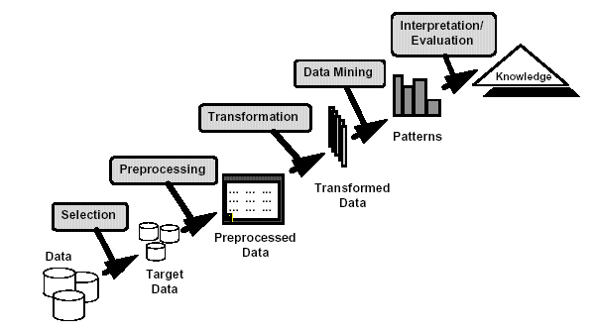
Knowledge Discovery

Slide 9
Examples of Large Datasets
Government: IRS, NGA, …
Large corporations
  WALMART: 20M transactions per day
  MOBIL: 100 TB geological databases
  AT&T 300 M calls per day
  Credit card companies
Scientific
  NASA, EOS project: 50 GB per hour
  Environmental datasets

Slide 10
Examples of Data mining Applications
1. Fraud detection: credit cards, phone cards
2. Marketing: customer targeting
3. Data Warehousing: Walmart
4. Astronomy
5. Molecular biology

Slide 11
How Data Mining is used
1. Identify the problem
2. Use data mining techniques to transform the data into information
3. Act on the information
4. Measure the results

Slide 12
The Data Mining Process
1. Understand the domain
2. Create a dataset:
  Select the interesting attributes
  Data cleaning and preprocessing
3. Choose the data mining task and the specific algorithm
4. Interpret the results, and possibly return to 2

Slide 13
Origins of Data Mining
Draws ideas from machine learning/AI, pattern recognition, statistics, and database systems
Must address:
  Enormity of data
  High dimensionality
  of data
  Heterogeneous,
  distributed nature
  of data
AI /
Machine Learning
Statistics
Data Mining
Database systems

Slide 14
Data Mining Tasks
1. Classification: learning a function that maps an item into one of a set of predefined classes
2. Regression: learning a function that maps an item to a real value
3. Clustering: identify a set of groups of similar items

Slide 15
Data Mining Tasks
4. Dependencies and associations:
identify significant dependencies between data attributes
5. Summarization: find a compact description of the dataset or a subset of the dataset

Slide 16
Data Mining Methods
1. Decision Tree Classifiers:
  Used for modeling, classification
2. Association Rules:
  Used to find associations between sets of attributes
3. Sequential patterns:
  Used to find temporal associations in time series
4. Hierarchical clustering:
used to group customers, web users, etc

Slide 17
Why Data Preprocessing?
Data in the real world is dirty
  incomplete: lacking attribute values, lacking certain attributes of interest, or containing only aggregate data
  noisy: containing errors or outliers
  inconsistent: containing discrepancies in codes or names
No quality data, no quality mining results!
  Quality decisions must be based on quality data
  Data warehouse needs consistent integration of quality data
  Required for both OLAP and Data Mining!

Slide 18
Why can Data be Incomplete?
Attributes of interest are not available (e.g., customer information for sales transaction data)
Data were not considered important at the time of transactions, so they were not recorded!
Data not recorder because of misunderstanding or malfunctions
Data may have been recorded and later deleted!
Missing/unknown values for some data

Slide 19
Data Cleaning
Data cleaning tasks
  Fill in missing values
  Identify outliers and smooth out noisy data
  Correct inconsistent data

Slide 20
Classification: Definition
Given a collection of records (training set )
  Each record contains a set of attributes, one of the attributes is the class.
Find a model for class attribute as a function of the values of other attributes.
Goal: previously unseen records should be assigned a class as accurately as possible.
  A test set is used to determine the accuracy of the model. Usually, the given data set is divided into training and test sets, with training set used to build the model and test set used to validate it.

Slide 21
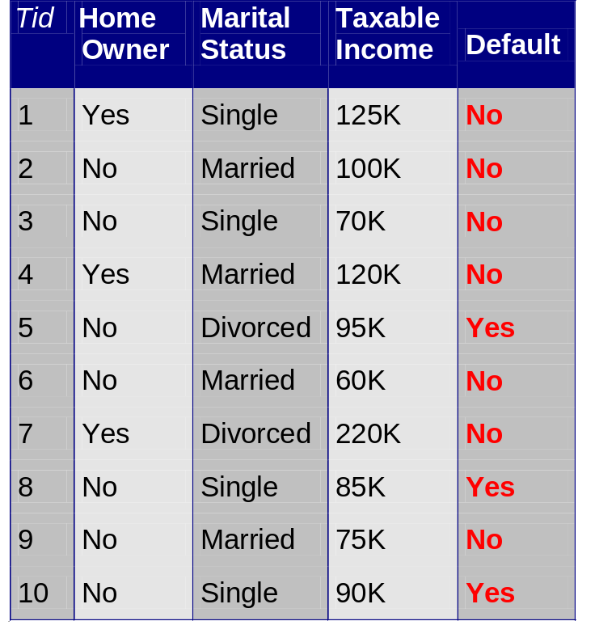
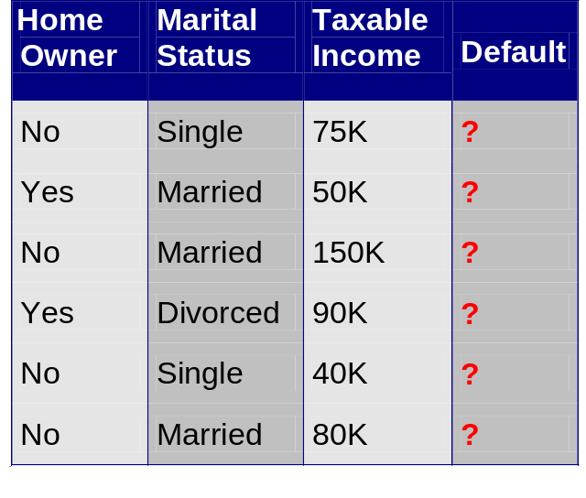
Classification Example
categorical
categorical
continuous
class
Test
Set
Learn
Classifier
Training
Set
Model

Slide 22
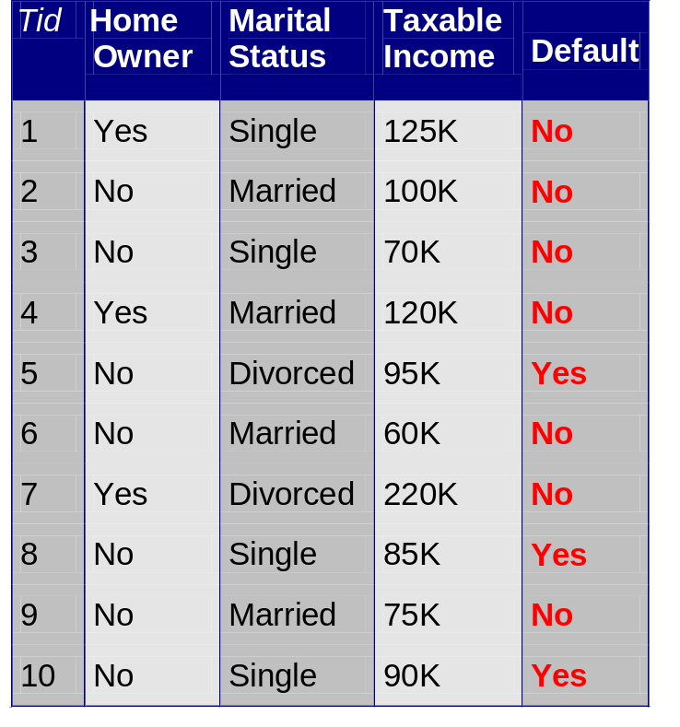
Example of a Decision Tree
categorical
categorical
continuous
class
Splitting Attributes
HO
Yes
No
NO
MarSt
Single, Divorced
Married
TaxInc
NO
< 80K
> 80K
NO
YES
Training Data
Model: Decision Tree

Slide 23
Another Example of Decision Tree
categorical
categorical
continuous
class
MarSt
Single, Divorced
Married
NO
HO
Yes
No
NO
TaxInc
< 80K
> 80K
NO
YES
There could be more than one tree that fits the same data!

Slide 24
Classification: Application 1
Direct Marketing
  Goal: Reduce cost of mailing by targeting a set of consumers likely to buy a new cell-phone product.
  Approach:
    Use the data for a similar product introduced before.
    We know which customers decided to buy and which decided otherwise. This {buy, don’t buy} decision forms the class attribute.
    Collect various demographic, lifestyle, and company-interaction related information about all such customers.
      Type of business, where they stay, how much they earn, etc.
    Use this information as input attributes to learn a classifier model.
From [Berry & Linoff] Data Mining Techniques, 1997

Slide 25
Classification: Application 2
Fraud Detection
  Goal: Predict fraudulent cases in credit card transactions.
  Approach:
    Use credit card transactions and the information on its account-holder as attributes.
      When does a customer buy, what does he buy, how often he pays on time, etc
    Label past transactions as fraud or fair transactions. This forms the class attribute.
    Learn a model for the class of the transactions.
    Use this model to detect fraud by observing credit card transactions on an account.

Slide 26
Clustering Definition
Given a set of data points, each having a set of attributes, and a similarity measure among them, find clusters such that
  Data points in one cluster are more similar to one another.
  Data points in separate clusters are less similar to one another.
Similarity Measures:
  Euclidean Distance if attributes are continuous.
  Other Problem-specific Measures.

Slide 27
Illustrating Clustering
Euclidean Distance Based Clustering in 3-D space.
Intracluster distances
are minimized
Intercluster distances
are maximized

Slide 28
Clustering: Application 1
Market Segmentation:
  Goal: subdivide a market into distinct subsets of customers where any subset may conceivably be selected as a market target to be reached with a distinct marketing mix.
  Approach:
    Collect different attributes of customers based on their geographical and lifestyle related information.
    Find clusters of similar customers.
    Measure the clustering quality by observing buying patterns of customers in same cluster vs. those from different clusters.

Slide 29
Clustering: Application 2
Document Clustering:
  Goal: To find groups of documents that are similar to each other based on the important terms appearing in them.
  Approach: To identify frequently occurring terms in each document. Form a similarity measure based on the frequencies of different terms. Use it to cluster.
  Gain: Information Retrieval can utilize the clusters to relate a new document or search term to clustered documents.

Slide 30
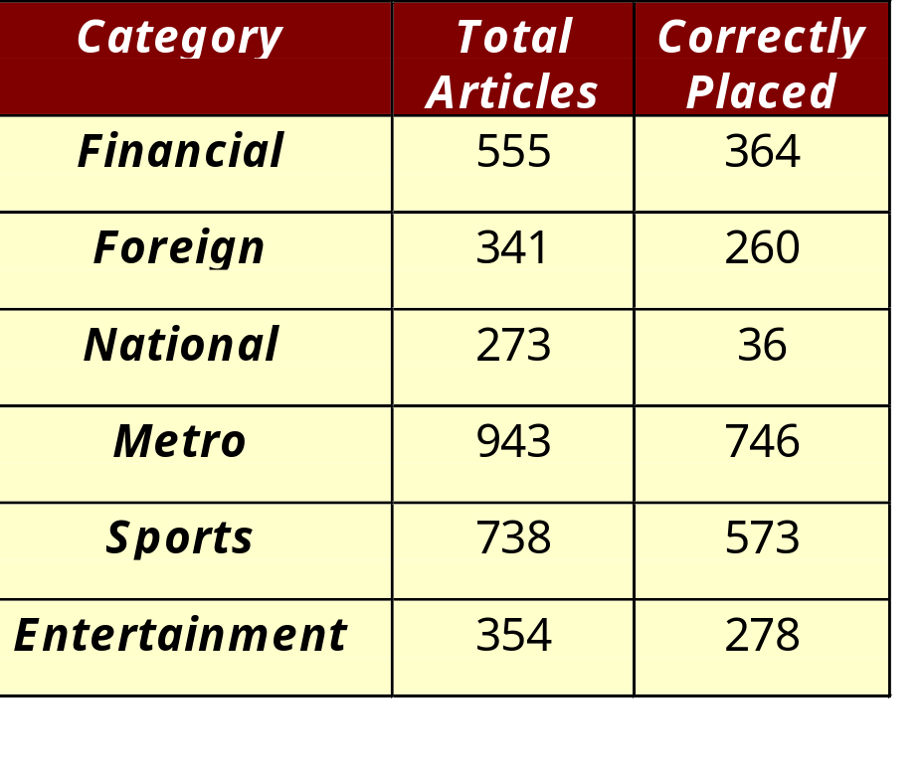
Illustrating Document Clustering
Clustering Points: 3204 Articles of Los Angeles Times.
Similarity Measure: How many words are common in these documents (after some word filtering).

Slide 31

Association Rule Discovery: Definition
Given a set of records each of which contain some number of items from a given collection;
  Produce dependency rules which will predict occurrence of an item based on occurrences of other items.
Rules Discovered:
{Milk} --> {Coke}
{Diaper, Milk} --> {Beer}

Slide 32
Association Rule Discovery: Application 1
Marketing and Sales Promotion:
  Let the rule discovered be
  {Bagels, … } --> {Potato Chips}
  Potato Chips as consequent => Can be used to determine what should be done to boost its sales.
  Bagels in the antecedent => Can be used to see which products would be affected if the store discontinues selling bagels.
  Bagels in antecedent and Potato chips in consequent => Can be used to see what products should be sold with Bagels to promote sale of Potato chips!

Slide 33
Data Compression
Original Data
Compressed
Data
lossless
Original Data
Approximated
lossy

Slide 34
Numerosity Reduction:
Reduce the volume of data
Parametric methods
  Assume the data fits some model, estimate model parameters, store only the parameters, and discard the data (except possible outliers)
Non-parametric methods
  Do not assume models
  Major families: histograms, clustering, sampling

Slide 35
Clustering
Partitions data set into clusters, and models it by one representative from each cluster
Can be very effective if data is clustered but not if data is “smeared”
There are many choices of clustering definitions and clustering algorithms, more later!

Slide 36
Sampling
Allow a mining algorithm to run in complexity that is potentially sub-linear to the size of the data
Choose a representative subset of the data
  Simple random sampling may have very poor performance in the presence of skew
Develop adaptive sampling methods
  Stratified sampling:
    Approximate the percentage of each class (or subpopulation of interest) in the overall database
    Used in conjunction with skewed data
Sampling may not reduce database I/Os (page at a time).

Slide 37
Sampling
SRSWOR
(simple random
sample without
replacement)
SRSWR
Raw Data

Slide 38
Sampling
Raw Data
Cluster/Stratified Sample
The number of samples drawn from each cluster/stratum is analogous to its size
Thus, the samples represent better the data and outliers are avoided

